Slide 1
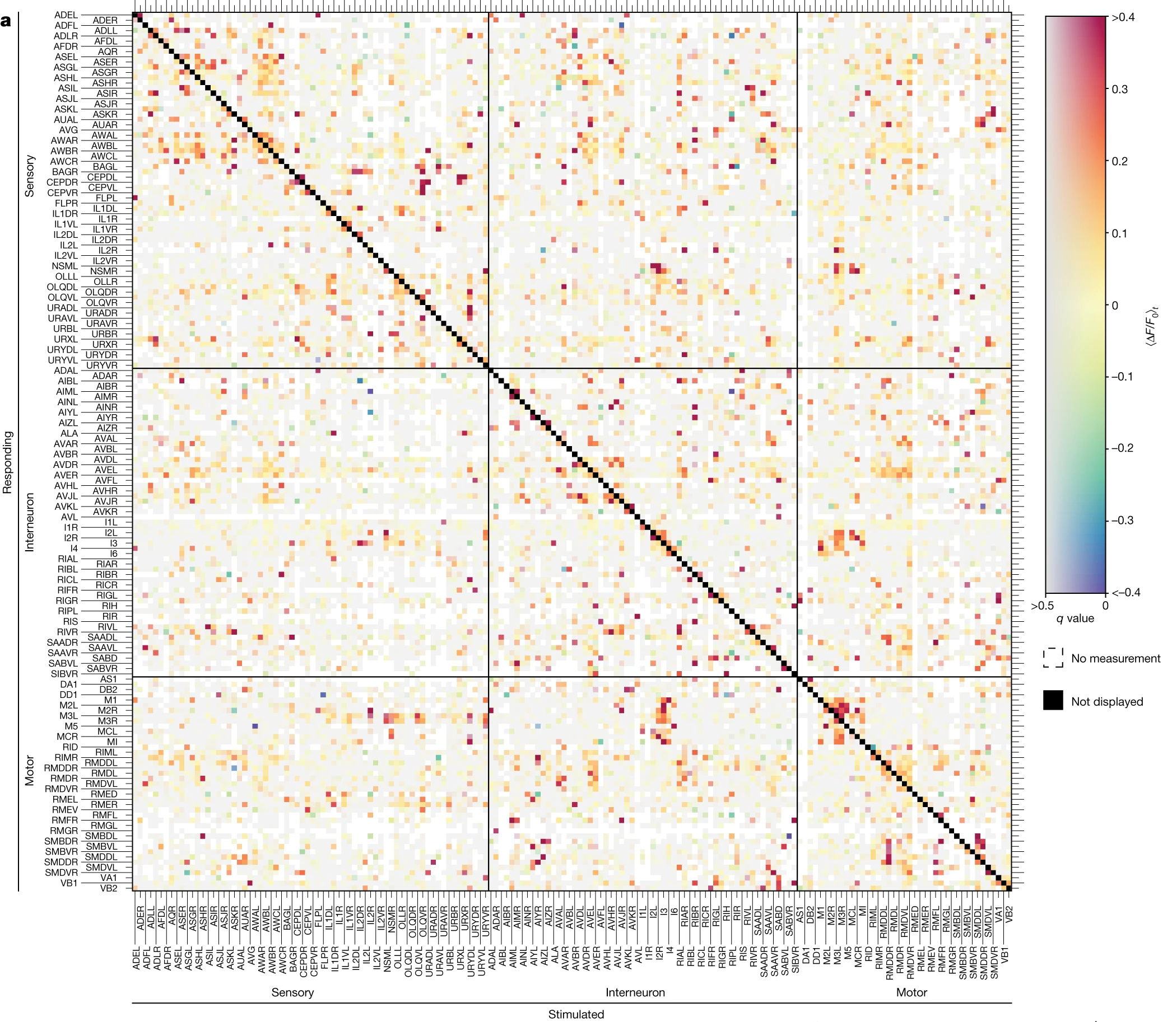
Neural signal propagation atlas of
Caenorhabditis elegans
Randi et al., nature, 2023 (fig.2a)
https://doi.org/10.1038/s41586-023-06683-4

